Slide 1
Predicting the Success of Telemarketing Campaign
Live Session : Project Discussion

Slide 2



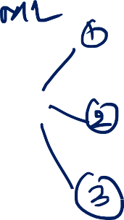
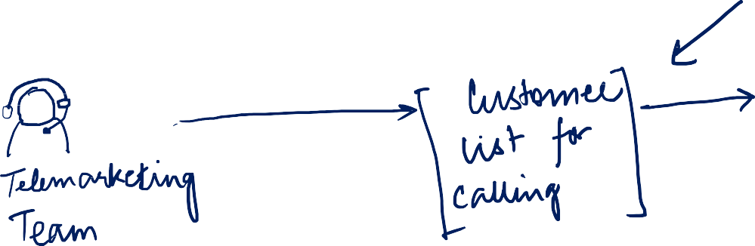


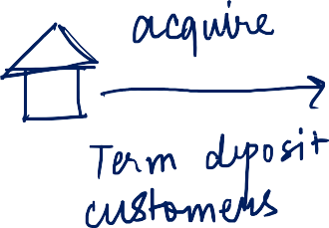










Problem Statement
“The Telemarketing Team of a Bank runs campaigns to expand the term deposit portfolio. You are requested to enable prioritization for the Telemarketing team, so that overall responses and ROI of the campaign increases”

Slide 3

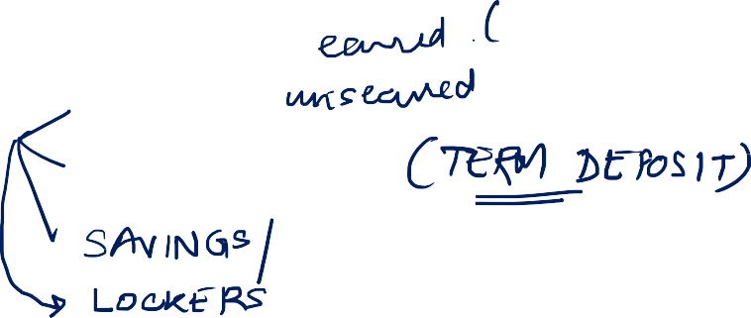







Some Definitions First
Marketing Channel : Avenue of communication to customer for Business Purpose
Telemarketing: It is a Marketing Channel where customers are called up for Offers
Portfolio: A group of customers under a product category
ROI : Acronym for Return on Investment

Slide 4







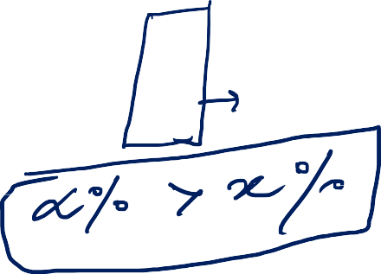



Why it Matters
Telemarketing Team generally has fixed resources
The team will have a fixed call handling capacity in a given time frame (suppose x calls/day)
If the Telemarketing team receives a pre-selected list of customers to call, then they can focus on them only
ROI will increase in 2 ways
Reduction of investment by not calling up everyone
Increase in rate of response among the prioritized customer list

Slide 5
Data Source
This dataset is based on "Bank Marketing" UCI dataset
The full description along with dataset is available here : http://archive.ics.uci.edu/ml/datasets/Bank+Marketing
This dataset is enriched with a few social and economic attributes
Due to confidentiality clauses all attributes are not mentioned
The binary classification goal is to predict if the client will subscribe a bank term deposit

Slide 6
























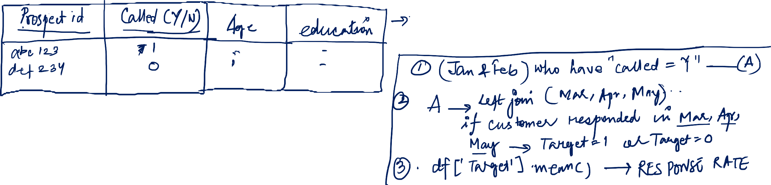



Data Capture Process

Slide 7





















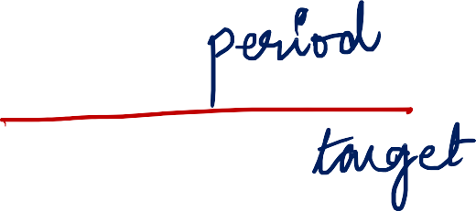
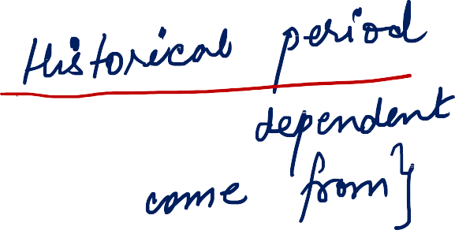





























Slide 8
Data Description
Variable | Description
Age | Age of Customer
Job | Type of Job (Categorical : “admin”, ”blue-collar”, “entrepreneur”, “housemaid”, ”management”, "retired","self- employed","services","student","technician","unemployed","unknown")
Marital | marital status(categorical:"divorced","married","single","unknown")
education | (categorical: “basic.4y”, “basic.6y”, “basic.9y”, “high.school”, “illiterate”, “professional.course”, “university.degree”, “unknown”)
default | default: has credit in default? (categorical: “no”, “yes”, “unknown”)
housing | housing: has housing loan? (categorical: “no”, “yes”, “unknown”)
loan | loan: has personal loan? (categorical: “no”, “yes”, “unknown”)
contact | contact: contact communication type (categorical: “cellular”, “telephone”)
month | month: last contact month of year (categorical: “jan”, “feb”, “mar”, …, “nov”, “dec”)
day_of_week | day_of_week: last contact day of the week (categorical: “mon”, “tue”, “wed”, “thu”, “fri”)
duration | duration: last contact duration, in seconds (numeric).
campaign | campaign: number of contacts performed during this campaign and for this client (numeric, includes last contact)
pdays | pdays: number of days that passed by after the client was last contacted from a previous campaign (numeric; 999 means client was not previously contacted)
previous | previous: number of contacts performed before this campaign and for this client (numeric)
poutcome | poutcome: outcome of the previous marketing campaign (categorical: “failure”, “nonexistent”,“success”)
emp.var.rate | emp.var.rate: employment variation rate — (numeric)
cons.price.idx | cons.price.idx: consumer price index — (numeric)
cons.conf.idx | cons.conf.idx: consumer confidence index — (numeric)
euribor3m | euribor3m: euribor 3 month rate — (numeric)
nr.employed | nr.employed: number of employees — (numeric)
y | target variable - has the client subscribed to term deposit (1/0)

Slide 9
Exploratory Data Analysis
Data Understanding – Univariate Analysis
How well populated is the data?
How much variation is there in the variables given to you?
What are the unique levels for the categorical variables
What is the proportion of missing data for the given raw variables? Discard variables that are
more than 25% missing in values
Missing Value Imputation Methods : Mean for Numeric and Mode for Categorical

Slide 10
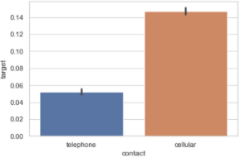
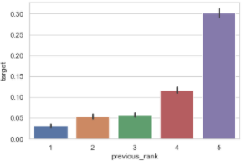
Bi-Variate Plots
Visualizations to reveal Bi-Variate data patterns and relationships
Plot Categorical Independent Variable Levels on X- Axis
Plot Average Value of Dependent Variable on Y-Axis
In case of Continuous Independent variable, break them into ranks and then plot them on
the X-Axis
Avg Value of Y
Avg Value of Y
Categorical Independent Variable
Ranks of Continuous Variable

Slide 11
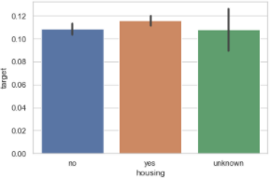
Insights : Bi-Variate Plots
We are looking for variables/features that differentiates the average value of Y
Based on plots we can determine which variables can predict Y
We can even group up some levels or club variable to achieve differentiation
Examples of good and bad outcome is given below to clearly explain the expectation
Bad Predictor
Good Predictor
Good Slope
No Slope
Avg Value of Y
Avg Value of Y
Categorical Independent Variable
Ranks of Continuous Variable

Slide 12
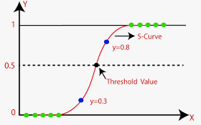
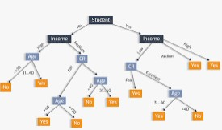
Classification Algorithms
Bi-directional approach : Both classifier algorithms (Statistical and ML Based) can be tried out and results compared for final deployment
Binomial LR Algorithm Tree Based ML Algorithm

Slide 13










Precision , Recall and F1 Score
Precision
 |  |  | Actuals
 |  |  | Positive | Negative
Model Predicted | Positive |  | A | B | Predicted Positive Rate | A/(A+B)
 | Negative |  | C | D | Predicted Negative Rate | D/(C+D)
 |  |  | Sensitivity | Specificity | Accuracy = (A+D) / (A+B+C+D)
 |  |  | A/(A+C) | D/(B+D)
2* Precision*Recall
Recall (True Positive Rate)
F1 Score
Precision + Recall

Slide 14
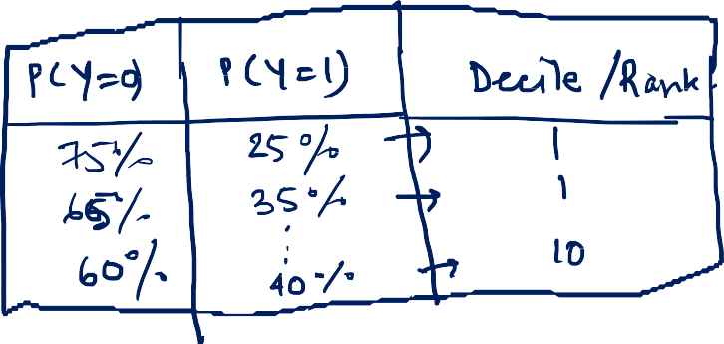




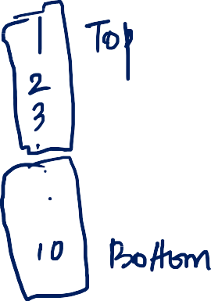




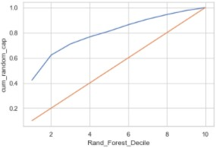
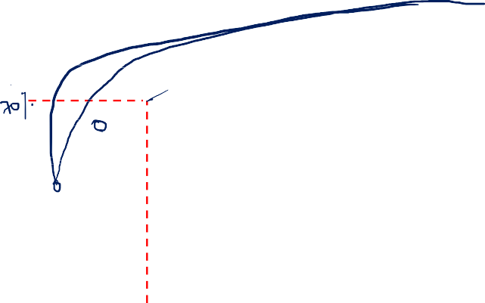



Gains Chart
Build deciles based on Predicted Probability
Summarize Data across the deciles to calculate the Cumulative Actual Event Capture Rate
Target=1 is Event and Target=0 is Non-Event
Compare Models based on the Cumulative Event Capture Rate till Decile 3
Example of Gains Chart

Slide 15














